Slide 1

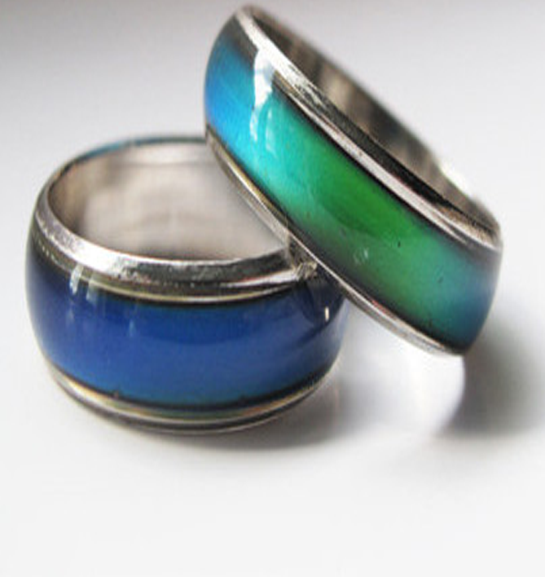
Sustainable Futures Air Quality Smart Ring
Team #4 March 2018

Slide 2
Agenda
The Problem
Who is Impacted?
The Solution
How it Works
Vision
Team

Slide 3
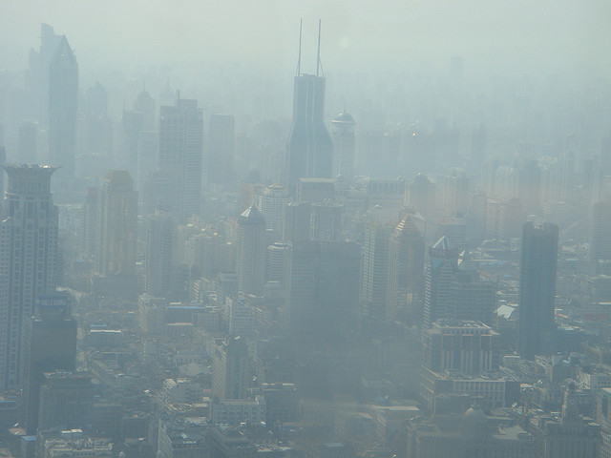

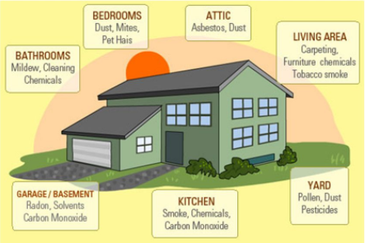

The Problem
Notes:
The new study, published in the journal The Lancet and written by more than 40 international health and environmental experts, uses data from the the Global Burden of Disease, an international study that examines trends across populations and estimates mortality from major diseases and their causes.
Air pollution was linked to 6.5 million deaths in 2015, water pollution was linked to 1.8 million deaths and workplace pollution was linked to nearly one million deaths.

Slide 4
Who is Impacted?

Slide 5
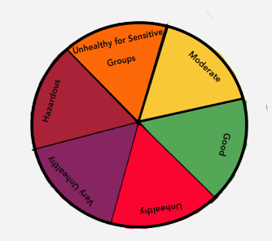
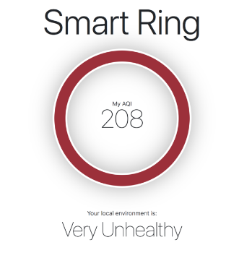
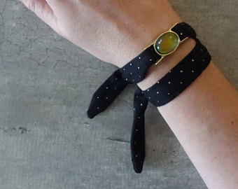
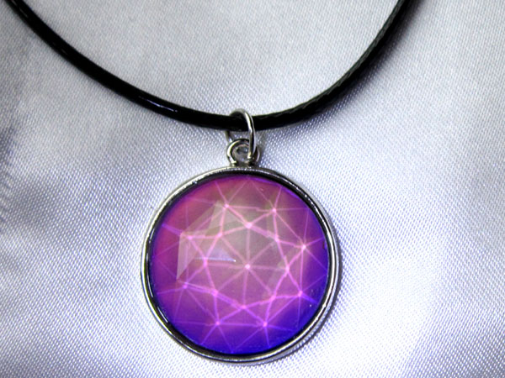
The Solution – Air Quality (AQ) Smart Ring

Slide 6
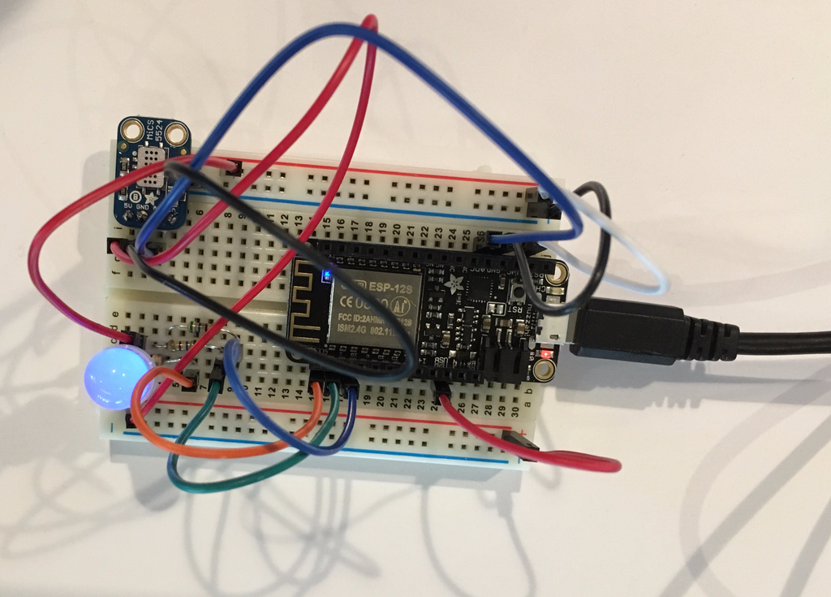
How it Works
Sensor:Adafruit MiCS5524 CO / Alcohol / VOC Gas Sensor Breakout
Microcontroller:Feather HUZZAH w/ ESP8226 Wifi
Indicator:Diffused RGB (tri-color) LED

Slide 7
Vision
Capabilities | Proof Of Concept | Release 1 | Release 2
Gas Sensor
Particle Sensor
Temperature Sensor
Wrist Band
Necklace
Ring
Geo Tracking
Identify Pollutant Type
ADA Accessible
Interface - Location EPA AQI
Social Responsibility Outreach

Slide 8
Meet Team 4 AQ Smart Ring!
Abbie Jones – Full Stack – Bike!
Cynthia Smith – Design – Run!
Evie Curry – Front End – Kayak!
Lynnae Griffiths – Back End – Rock Climb!
Sunmi Bausmann – Front End – SUP!
Traci Esteve – Product Manager – Scuba!

Slide 9
Air Quality Smart Ring: What Color is Your Air?

